Slide 1

How to get full points on your text
4B SA Writing Task
2 Example Texts

Slide 2
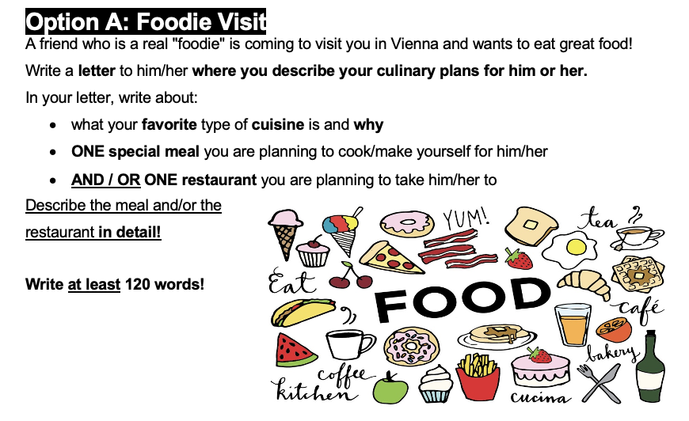

Slide 3
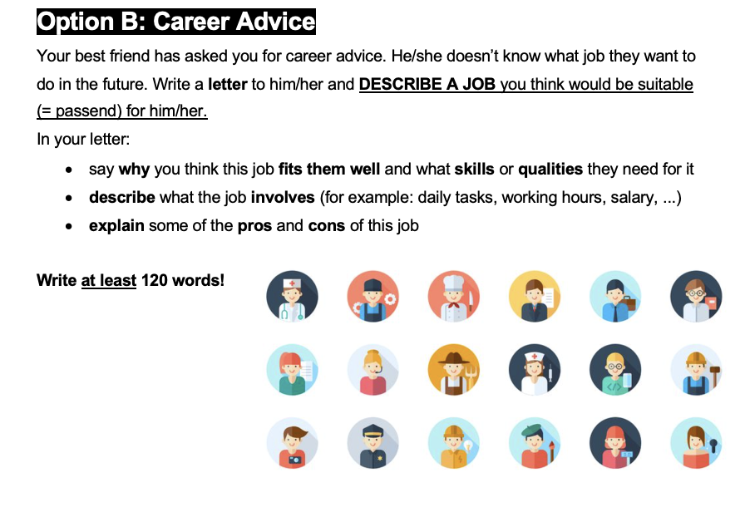

Slide 4
The categories we analyze for each text
LANGUAGE FACTORS
TASK ACHIEVEMENT
Advanced vocabulary
Favourite cuisine / Why job fits
Great descriptions and details
Meal you cook or eat / What the job involves
Restaurant details / Pros and cons of the job

Slide 5

MODEL TEXT
Student A
01
Option A:
Foodie Visit

Slide 6
Student A: Opening
Setting the scene with personal connection
RESTAURANT
STUDENT TEXT
Dear Marianna,
MEAL
You texted me and told me you're arriving in Vienna tomorrow, so I wanted to recommend a restaurant to you since I know how you love food. I will also cook for you, so you don't have to eat take out.
PERSONAL TOUCH

Slide 7
Student A: Cuisine + Homemade Meal
Two bullet points covered in one natural paragraph
FAVOURITE CUISINE ✓
STUDENT TEXT
MEAL DETAILS ✓
My favourite cuisine is Japanese cuisine, so I've learnt how to make sushi and I'm sure you'll like it. I usually make it with some salmon and some cucumbers, but since you hate cucumbers, I'll replace them with some cream cheese.
PERSONAL DETAIL

Slide 8
Student A: Restaurant Introduction
Setting up the detailed description
RESTAURANT ✓
STUDENT TEXT
ATMOSPHERE
You told me you wanted to visit a nice restaurant, so I found one. It's called 808 and it's located near the city center. It's a beautiful and cozy restaurant. My favourite dish there is their truffle pasta.
VOCABULARY

Slide 9
Student A
Vivid, sensory details
SENSORY DETAILS
STUDENT TEXT
ADVANCED VOCABULARY
It's full of flavour, hot and the preparation is definitely worth watching. The waiter brings the boiled pasta right to your table and throws it into a huge parmesan wheel. He adds a tiny bit of alcohol and a blue fire starts. He mixes it with the melting cheese right in front of you and grates some black truffles on top of it.
RESTAURANT DETAIL ✓✓

Slide 10
Student A: Strong Finish
VIVID EXPRESSION
STUDENT TEXT
The flavour is incredible. The tenderness of the pasta and the flavour of the truffles will make your taste buds go crazy. It's also really filling and not fattening at all. I'm definitely taking you to that place!
VOCABULARY
PRACTICAL INFO
Best regards,
Student A

Slide 11

MODEL TEXT
Student B
02
Option B: Career Advice

Slide 12
Student B: Why This Job Fits
Direct and clear opening
JOB IDENTIFIED
STUDENT TEXT
Dear Stella,
WHY IT FITS ✓
I think it's great that you want to become a children's doctor. This job is perfect for you because you are kind, patient and responsible.

Slide 13
Student B: What the Job Involves
Detailed discussion daily tasks and requirements of the job
DAILY TASKS ✓
STUDENT TEXT
As a children's doctor, you will help babies and kids, do check-ups, find out what's wrong, and tell parents what to do. You can work in a doctor's office or hospital, and you will see regular visits, shots and sometimes emergencies. You need to know a lot about medicine, talk well with others, work in a team, and stay calm when things are hard.
WORK SETTINGS ✓
VARIETY OF WORK ✓
SKILLS NEEDED ✓

Slide 14
Student B: Pros and Cons
Balanced, honest assessment
PROS ✓
Helping children (meaningful)
Variety of tasks
Job security ("steady job")
STUDENT TEXT
The good things about this job are helping children, doing many different tasks, and having a steady job. The hard parts are long work hours, feeling sad sometimes, and learning all the time.
CONS ✓
Long hours
Emotional factors ("feeling sad")
Constant learning required
Parallel structure: Three pros, three cons - balanced and easy to follow.

Slide 15
Student B: Supportive Closing
Personal encouragement and offer of help
ENCOURAGEMENT
STUDENT TEXT
I think you will be very good at it! I'm here to help you with your studies anytime.
OFFER OF SUPPORT
Best wishes,
Student B

